Slide 1
Bureau of Residential Facilities Licensing
Updates and Top 10
Presenting To
Arizona Assisted Living Home Association| 06 March 2024
Presented by
Jim Tiffany, Compliance Officer Supervisor
Bureau of Residential Facilities Licensing

Slide 2
What Will Be Covered
Bureau of Residential Facilities Licensing (BRFL) Overview
Assisted Living Facility Data
Top 10 Deficiencies
BRFL and Statutory Updates
Maintaining compliance
Available Online Tools and Resources

Slide 3
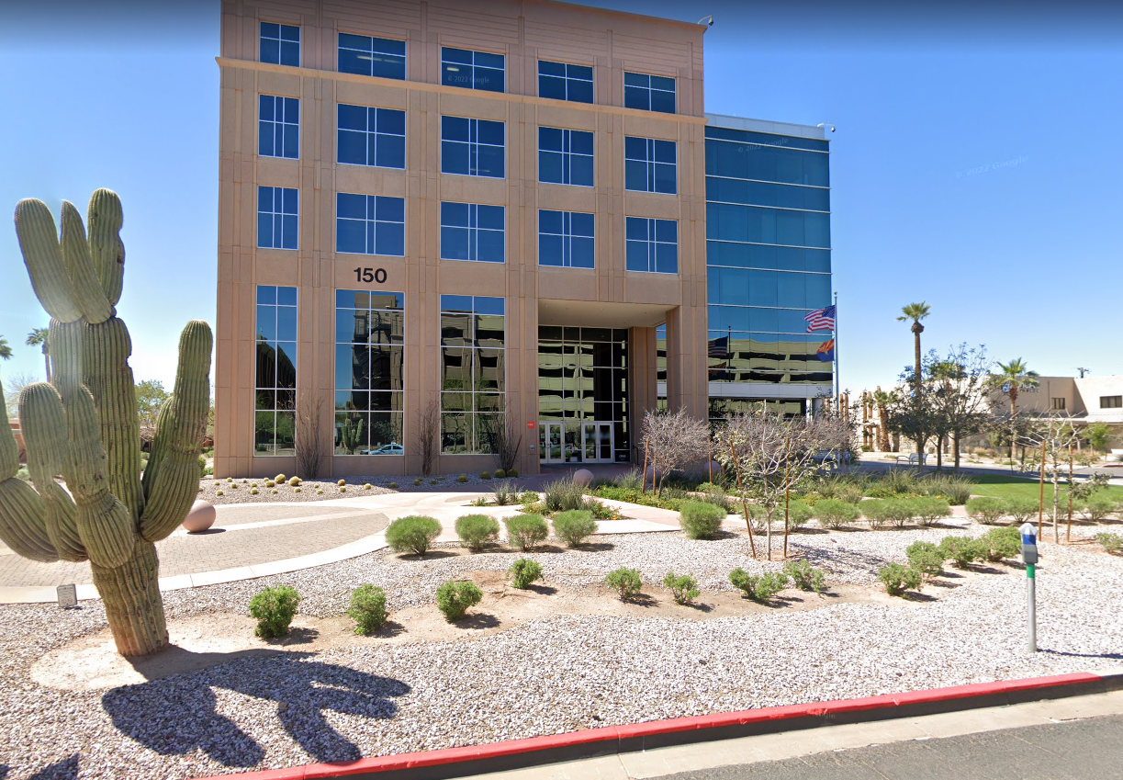
Office Location and Contact Information
Address: 150 N. 18th Ave., Suite 460, Phoenix, AZ 85007
Phone: 602-364-2639
Fax: 602-324-5872
Website: www.azdhs.gov/residentialfacilities
Email: Residential.Licensing@azdhs.gov
Please note the Tucson office (located at 400 W. Congress) is now closed to the public/walk-ins. All in-person communication must be done at the Phoenix office location

Slide 4
Arizona Department of Health Services
Jennie Cunico, Cabinet Executive Officer/ Executive Deputy Director
Division of Public Health Licensing
Tom Salow, Assistant Director
Bureau of Residential Facilities Licensing
Dawn Butler, Bureau Chief

Slide 5
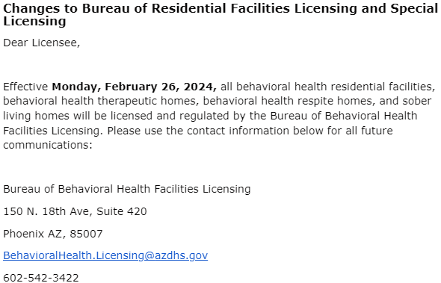

Slide 6
ADHS Vision, Mission, and Tools
Our Vision:
  Health and Wellness for all Arizonans
Our Mission:
  To promote, protect, and improve the health and wellness of individuals and communities in Arizona
Our Regulatory Authority:
  Arizona Revised Statutes (Title 36, Chapter 4: Public Health and Safety)
  Arizona Administrative Code (Title 9, Chapter 10: Health Care Institutions Licensing)

Slide 7
Bureau of Residential Facilities Licensing (“BRFL”)
Mission Statement:
“To protect the health and safety of Arizonans by providing information, establishing standards, and licensing and regulating health and child care services.”

Slide 8
Assisted Living Facility Data

Slide 9
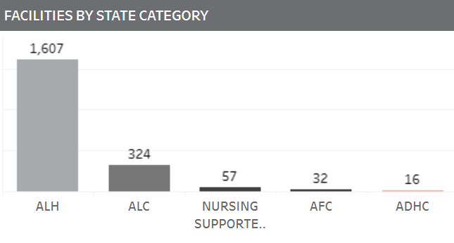
Residential Health Care Institutions
(Total = 2,036 / 1,931 ALH or ALC)
*Facility totals as of 03/01/2024

Slide 10
Top 10 Deficiencies in
Assisted Living Homes
(Since March 1, 2023)

Slide 11

#10
R9-10-806(A)(7). Personnel
A. A manager shall ensure that:
7. Documentation is maintained for at least 12 months after the last date on the documentation of the caregivers and assistant caregivers working each day, including the hours worked by each;

Slide 12

#9
R9-10-807(B)(1)(a)-(b):
R9-10-807. Residency and Residency Agreements
B. A manager shall ensure that before or at the time of acceptance of an individual, the individual submits documentation that is dated within 90 calendar days before the individual is accepted by an assisted living facility and:
1. If an individual is requesting or is expected to receive supervisory care services, personal care services, or
directed care services:
a. Includes whether the individual requires:
i. Continuous medical services,
ii. Continuous or intermittent nursing services, or
iii. Restraints; and

Slide 13

#8
R9-10-818(A)(4):
R9-10-818. Emergency and Safety Standards
A. A manager shall ensure that:
4. A disaster drill for employees is conducted on each shift at least once every three months and documented;

Slide 14
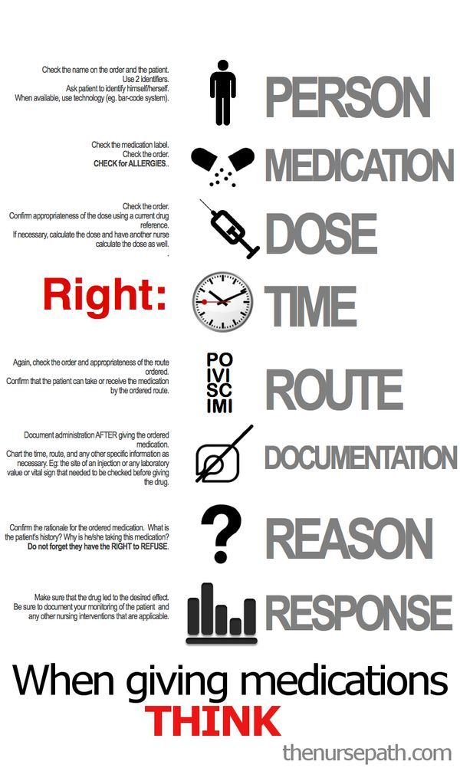
#6
R9-10-816(B)(3)(c):
R9-10-816. Medication Services
B. If an assisted living facility provides medication administration, a manager shall ensure that:
3. A medication administered to a resident:
c. Is documented in the resident’s medical record.

Slide 15

#6
R9-10-815(F)(2)(a)(i)-(ii):
R9-10-815. Directed Care Services
F. A manager of an assisted living facility authorized to provide directed care services shall ensure that:
2. There is a means of exiting the facility for a resident who does not have a key, special knowledge for egress, or the ability to expend increased physical effort that meets one of the following:
a. Provides access to an outside area that:
i. Allows the resident to be at least 30 feet away from the facility, and
ii. Controls or alerts employees of the egress of a resident from the facility

Slide 16

#5
R9-10-808(C)(1)(g):
R9-10-808. Service Plans
C. A manager shall ensure that:
1. A caregiver or an assistant caregiver
g. Documents the services provided in the resident’s medical record

Slide 17
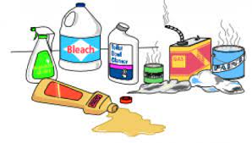
#4
R9-10-819(A)(11):
R9-10-819. Environmental Standards
A. A manager shall ensure that:
11. Poisonous or toxic materials stored by the assisted living facility are maintained in labeled containers in a locked area separate from food preparation and storage, dining areas, and medications and are inaccessible to residents

Slide 18
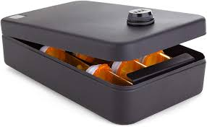
#3
R9-10-816(F)(1):
R9-10-816. Medication Services
A. When medication is stored by an assisted living facility, a manager shall ensure that:
1. Medication is stored in a separate locked room, closet, cabinet, or self-contained unit used only for medication storage;

Slide 19
#2
R9-10-816(B)(3)(b):
R9-10-816. Medication Services
B. If an assisted living facility provides medication administration, a manager shall ensure that:
3. A medication administered to a resident:
b. Is administered in compliance with a medication order, and

Slide 20

#1
A.R.S. § 36-420.01. Health care institutions; fall prevention and fall recovery; training programs; definition
A. Each health care institution shall develop and administer a training program for all staff regarding fall prevention and fall recovery. The training program shall include initial training and continued competency training in fall prevention and fall recovery. A health care institution may use information and training materials from the department's Arizona falls prevention coalition in developing the training program.

Slide 21
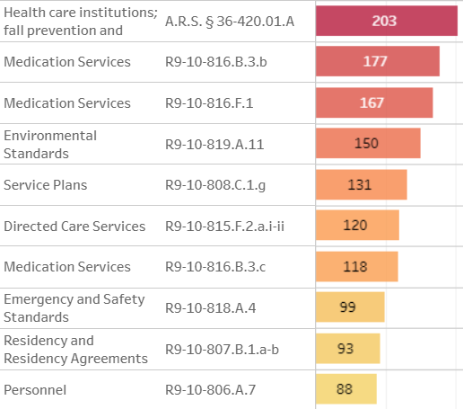
Top 10 Overview

Slide 22
Updates

Slide 23
TB Rules A.A.C. R9-10-113
Facility needs a TB Infection Control Program
Annually provide in-service training for signs and symptoms of TB infection
Annually assess the facility’s risk of exposure
  This assessment is very simple, as all they need to determine if there has been any infections within the facility and what the overall risk is to the facility
  This assessment does not require TB testing/symptom screening at that time
Report suspected infectious TB to local health department and do any contact tracing if necessary

Slide 24
TB Rules A.A.C. R9-10-113 (Personnel)
New employees need a TB test and baseline symptom screening
  2 step TB skin test OR 1 TB blood test
  2 step TB skin test can be done 1-3 weeks apart
  Baseline symptom screening is signed by an RN, Medical Practitioner, or local health department
Employees with positive TB Skin tests or blood test will need documentation from a medical practitioner that they are free from infectious TB
Employees with latent TB will need annual documentation of symptom screening for the remainder of their employment
  Annual symptom screening is signed by an RN, Medical Practitioner or local health department
Employees with negative baseline TB test or employees who’s positive test was due to vaccination, does not need any additional testing or symptom screening for the remainder of their employment

Slide 25
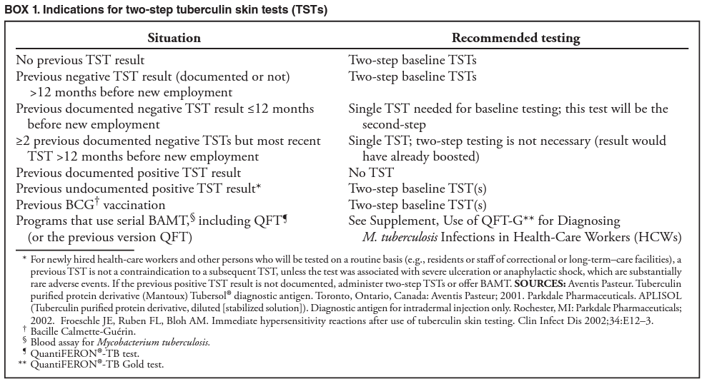
Two-step Tuberculin Skin Tests

Slide 26
TB Rules A.A.C. R9-10-113 (Resident)
New Residents – within 7 calendar days, documentation of freedom from infectious TB and baseline symptom screening
  They are not required to do the 2-step TB skin test
  We will accept 1 negative TB skin test OR 1 negative TB blood test
  If the TB skin test or TB blood test is positive, we need documentation from a medical practitioner that they are free from infectious TB
  Baseline symptom screening is signed by a RN, medical practitioner, or local health department
  If the skin test or blood test is negative, no further documentation is needed annually for the remainder of their residency.
If the resident has latent TB, they will need annual symptom screening signed by an RN, medical practitioner or local health department. If their positive test was due to a vaccination, they do not need annual symptom screening.

Slide 27

A.R.S. § 36-411
Fingerprint Clearance Cards (“FPCC”), effective September 24, 2022
Approved House Bill (HB) 2049, amending Arizona Revised Statutes (A.R.S.) § 36-411
Prohibits residential care institutions, nursing care institutions or home health agencies from allowing employees, volunteers or contracted persons from continuing employment or providing services if the person has been denied a FPCC or has had a FPCC suspended or revoked
HB2049 eliminates A.R.S. 36-411(H) and A.R.S. 36-411(I). Therefore, employees who previously met this requirement will be required to obtain a valid fingerprint clearance card
HB 2049 defines “direct supportive services”

Slide 28
A.R.S. § 36-420
Staff shall initiate CPR and First Aid if advanced directives allows for it, before EMS arrives to the facility
Facilities may not establish or implement policies that prevent employees from providing CPR and First Aid
We are receiving reports from Fire Departments and investigating them

Slide 29
A.R.S. § 36-420.04
SB 1157 Passed and went into effect on December 31, 2023
An assisted living home that contacts an emergency responder on behalf of a resident shall provide to the emergency responder a written document that provides EMS with the required information for resident transfer.

Slide 30
A.R.S. § 36-420.04
Partial list:
The reason or reasons the emergency responder was requested on behalf of the resident.
Complete medication list, pharmacy, PCP, & representative contact information
A list of any known allergies
Basic information about the resident's physical and mental conditions and basic medical history
A copy of the resident's advance directive(s)

Slide 31
A.R.S. § 36-420.04
This document must be maintained for all residents
The document must be standardized for all residents
The document must be kept up-to-date
The reason for calling EMS is added at the time

Slide 32
Nursing-Supported Group Homes
BRFL took over NSGHs on 26 February 2024
DDD Group Homes for residents who:
  Require continuous nursing intervention
  Require nursing oversight
Up to six (6) residents
Article 22: R9-10-2201 through R9-10-2226

Slide 33
Nursing-Supported Group Homes
A.R.S. § 36-401.A.38. "Nursing-supported group home" means a health care institution that is a community residential setting as defined in section 36-551 for not more than six persons with developmental disabilities, that is operated by a service provider under contract with the department of economic security and that provides room and board, daily habilitation and continuous nursing support and intervention.

Slide 34
Maintaining Compliance

Slide 35
Maintaining Compliance
Common items (not a comprehensive list) referred to the Enforcement Team include:
  Negative outcomes related to resident health and safety
  Repeat/uncorrected deficiencies
  Fingerprinting issues
  Personnel issues
  Residents left alone
  Over Capacity/Unlicensed Care
  False and misleading information/documentation

Slide 36
Reminders
All communication from the Bureau of Residential Facilities Licensing is done through email and phone
Please ensure we have the correct email address to avoid missing critical information
  Update BOTH the Bureau and the online portal
Please contact your assigned surveyor or the surveyor of the day if you have any questions
Read all communications from the Department carefully as there may be critical deadlines

Slide 37
Fraudulent emails
All communications from the Department will come from email addresses with an “@azdhs.gov” domain name. If you are in doubt as to whether a communication from the Department is genuine, please call our office at 602-364-2639 or email us at residential.licensing@azdhs.gov to verify it.

Slide 38
Please check the BRFL website for updates, tools, & resources

Slide 39
Online Resources
Bureau of Residential Facilities Licensing:
  http://azdhs.gov/licensing/residential-facilities/index.php
    Frequently asked questions
    License application forms
    How to prepare a Plan of Correction (POC)
    Informal Dispute Resolution process
    Links to rules, statutes, enforcement actions
  www.azcarecheck.com: facility information, including survey history and enforcement actions for the last 3 years for all active facilities

Slide 40

Online Resources

Slide 41
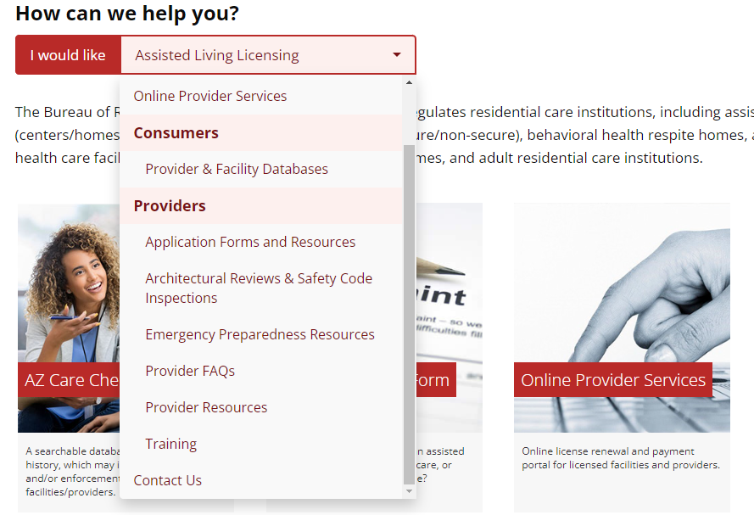
Online Resources

Slide 42
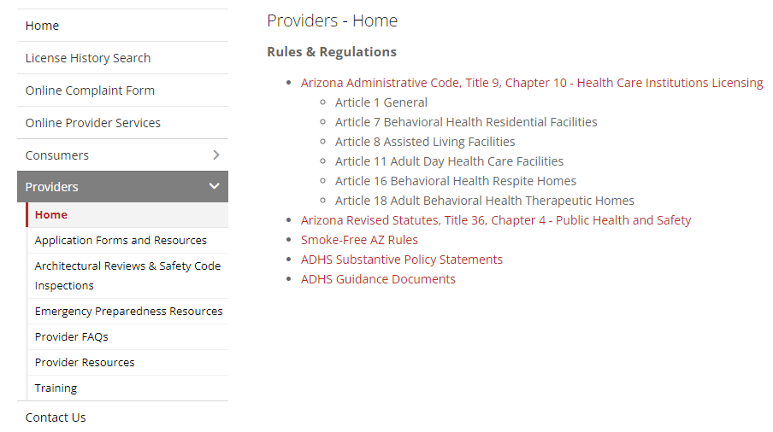
Online Resources

Slide 43

Questions
If you have any licensing/application process questions for our administrative support staff team or any questions about the survey process or regulations for our Compliance Officer of the Day, please call us at 602-364-2639
OR
Via email at Residential.Licensing@azdhs.gov

Slide 44



Bureau of Residential Facilities Licensing
azdhs.gov @azdhs facebook.com/azdhs

